Slide 1

Customer Segmentation
By Krishnakant Sonji

Slide 2
Introduction
Objective: To analyze and build a predictive model using multiple algorithms and select the best solution.
Dataset Overview:
Total Records: 976,320 Total Features: 44 Key Features: customer_age, household_income, customer_seniority_months, start_of_month_customer_relation, etc.
Goal: Achieve high predictive accuracy while meeting business requirements for interpretability.

Slide 3
Solution Overview - 1
Approach: Logistic Regression
Used as a baseline model due to its simplicity and interpretability. Logistic Regression calculates the probability of each class based on a weighted sum of features.
Model Performance:
Accuracy: 99.98%
Precision and Recall: Near-perfect scores across all classes, indicating minimal misclassification.
Strengths and Limitations:
Strengths: High interpretability, easy to understand feature contributions through coefficients, and straightforward implementation.
Limitations: May struggle with non-linear relationships and complex data structures.

Slide 4
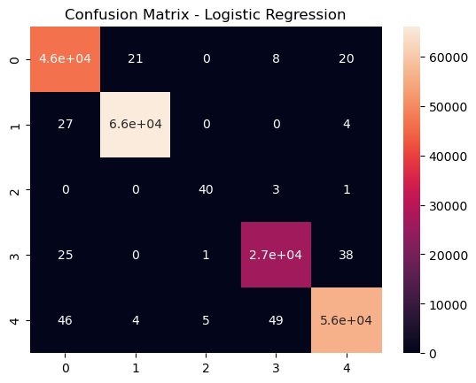
Confusion Matrix:

Slide 5
Solution Overview - 2
Approach: Random Forest Classifier A powerful ensemble model that builds multiple decision trees and aggregates their predictions for a final result. Known for handling complex data and interactions between features effectively.
Model Performance:
Accuracy: 99.91% Feature Importance: Identified key features like start_of_month_customer_relation as highly influential in predictions.
Strengths and Limitations:
Strengths: Good balance of accuracy and interpretability (through feature importance scores), robust against overfitting and handles large datasets well.
Limitations: Less interpretable than simpler models, computationally intensive.

Slide 6
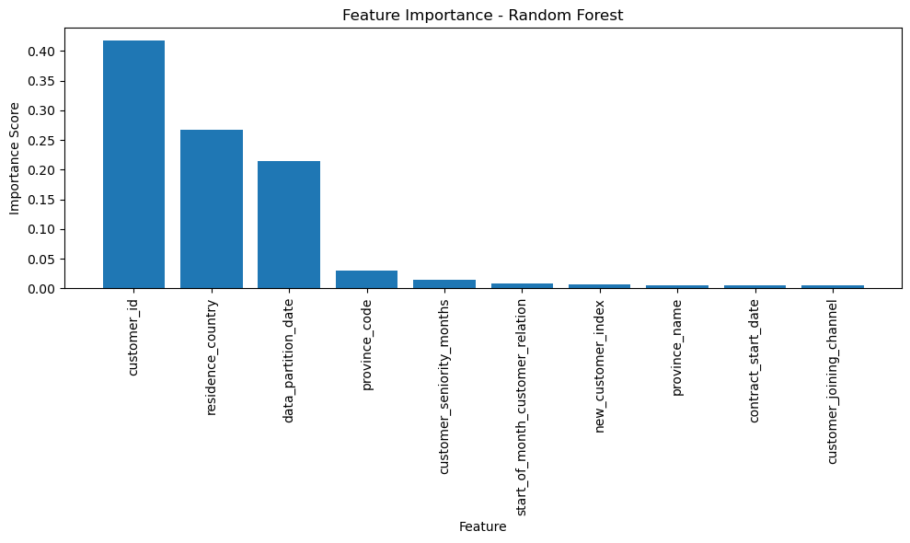
Feature Importance Plot:

Slide 7
Comparison of Models: Logistic Regression vs. Random Forest
Metric | Logistic Regression | Random Forest (RF)
Accuracy | 99.98% | 99.91%
Precision | 1.00 | 1.00
Recall | 1.00 | 1.00 (slightly lower for some classes)
F1-Score | 1.00 | 1.00
Interpretability | High (clear feature importance via coefficients) | Moderate (feature importance, but more complex)
Computation | Fast | Slower, more resource-intensive
Handling Complexity | Low (limited with complex, non-linear relationships) | High (good for complex and non-linear data)

Slide 8
Comparison of Models: Logistic Regression vs. Random Forest
Key Insights:
Logistic Regression: Provides high accuracy with excellent interpretability, as it allows us to understand feature contributions through coefficients. It’s efficient and performs well but may struggle with complex, non-linear patterns.
Random Forest: Delivers high accuracy with the ability to handle complex data structures. Its feature importance scores offer interpretability, though less straightforward than Logistic Regression. It is computationally more demanding but better suited for complex patterns in the data.
Conclusion:
Final Choice: If interpretability is the highest priority, Logistic Regression is preferable. However, if the ability to model complex interactions and achieve robustness against overfitting is crucial, Random Forest may be the better choice.
Team’s Decision: Based on the group’s discussions, the selected model will depend on balancing these factors in alignment with project requirements.

Slide 9
Selected Solution
Chosen Model: Random Forest
Reasons for Selection:
Balanced Performance: High accuracy (99.91%) with strong recall and precision across all classes.
Complexity Handling: Well-suited for datasets with complex relationships and interactions between features.
Interpretability: Provides feature importance scores, offering insights into which features influence predictions the most, although less directly interpretable than Logistic Regression.
Alignment with Requirements: Satisfies project requirements for high performance and moderate interpretability.

Slide 10
Conclusion
Summary of Findings:
Random Forest achieved high accuracy and precision, meeting the project’s performance goals.
The model provides a good balance of interpretability through feature importance and can handle complex data relationships.
Final Model Justification:
Selected based on its robust performance, ability to handle complexity, and alignment with project requirements for both accuracy and interpretability.

Slide 11
Future Improvements
Model Enhancements:
Hyperparameter Tuning: Further tuning could enhance the model’s performance and efficiency.
Experiment with Boosting Models: Testing models like Gradient Boosting or XGBoost for potentially higher accuracy.
Data Improvements:
Feature Engineering: Create additional features or transformations to improve predictive power.
Data Collection: Gather more balanced data to address any class imbalances.
Other Considerations:
Explainability Tools: Use SHAP or LIME for enhanced model interpretability if required by the business.

Slide 12
Thank you!

